Slide 1
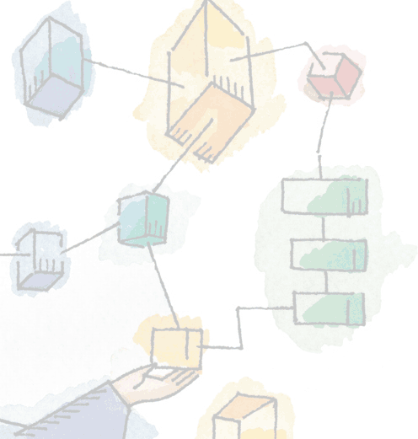
Operating Systems: Internals and Design Principles, 6/E
William Stallings
Memory Management

Slide 2
Memory Management
Memory needs to be allocated to ensure a reasonable supply of ready processes to . consume available processor time

Slide 3
Memory Management Terms
Table 7.1 Memory Management Terms
Term | Description
Frame | Fixed-length block of main memory.
Page | Fixed-length block of data in secondary memory (e.g. on disk).
Segment | Variable-length block of data that resides in secondary memory.

Slide 4
Types of Partitioning
Fixed Partitioning
Dynamic Partitioning
Simple Paging
Simple Segmentation
Virtual Memory Paging
Virtual Memory Segmentation

Slide 5
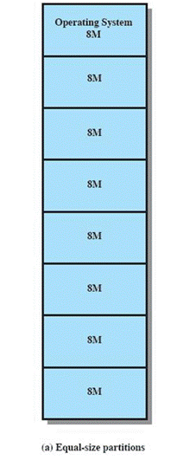
Fixed Partitioning
:Equal-size partitions
Any process whose size is less than or equal to the partition size can be loaded into an available partition.
The operating system can swap a process out of a partition:
If none are in a ready or running state.

Slide 6
Fixed Partitioning Problems
A program may not fit in a partition
The programmer must design the program with overlays.
Main memory use is inefficient
Any program, no matter how small, occupies an entire partition.
This is results in internal fragmentation

Slide 7
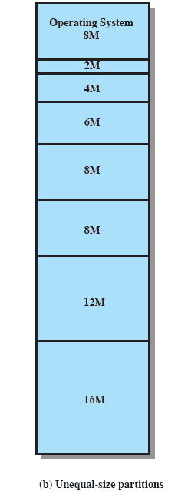
Solution – Unequal Size Partitions
Lessens both problem doesn’t solve completely
Smaller programs can be placed in smaller partitions, reducing internal fragmentation

Slide 8
Placement Algorithm
:Equal-size
(Placement is trivial (no options
:Unequal-size
Can assign each process to the smallest partition within which it will fit.
Processes are assigned in such a way as to minimize wasted memory within a partition.

Slide 9
Remaining Problems with Fixed Partitions
The number of active processes is limited by the system:
limited by the pre-determined number of partitions.
A large number of very small process will not use the space efficiently:
In either fixed or variable length partition methods.

Slide 10
Dynamic Partitioning
Partitions are of variable length and number.
Process is allocated exactly as much memory as required.

Slide 11
Dynamic Partitioning Example
External Fragmentation
Memory external to all processes is fragmented
Can resolve using
compaction
OS moves processes so that they are contiguous
Time consuming and wastes CPU time
OS (8M)
P2 (14M)
P1
(20M)
Empty (6M)
P4(8M)
Empt_{P2}y
(5₍₁6₄M_{M})₎
Empty (6M)
P3 (18M)
Empty (4M)
Refer to Figure 7.4

Slide 12
Dynamic Partitioning
Operating system must decide which free block to allocate to a process:
Best-fit algorithm:
Chooses the block that is closest in size to the request.
Worst performer overall.
Since smallest block is found for process, the smallest amount of fragmentation is left.
Memory compaction must be done more often.

Slide 13
Dynamic Partitioning
:First-fit algorithm
Scans memory form the beginning and chooses the first available block that is large enough.
Fastest.
May have many process loaded in the front end of memory that must be searched over when trying to find a free block.

Slide 14
Dynamic Partitioning
Next-fit:
Scans memory from the location of the last placement.
More often allocate a block of memory at the end of memory where the largest block is found.
The largest block of memory is broken up into smaller blocks.
Compaction is required to obtain a large block at the end of memory.

Slide 15
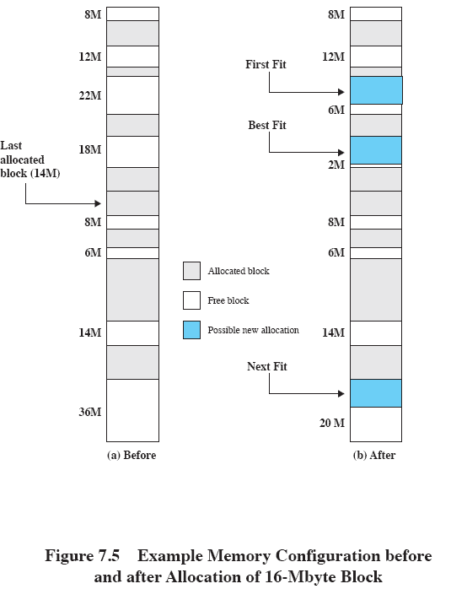
Allocation

Slide 16
Paging
Partition memory into small equal fixed- size chunks and divide each process into the same size chunks.
The chunks of a process are called pages.
The chunks of memory are called frames.

Slide 17
Paging
Operating system maintains a page table for each process.
Contains the frame location for each page in the process.
Memory address consist of a page number and offset within the page.

Slide 18
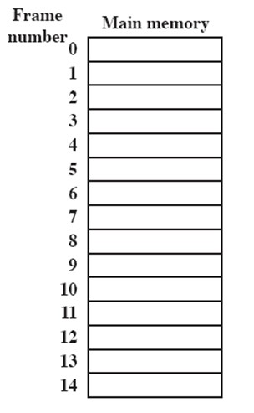
Processes and Frames
A.0
A.1
A.2
A.3
D.0
D.1
D.2
C.0
C.1
C.2
C.3
D.3
D.4
B.0
B.1
B.2

Slide 19
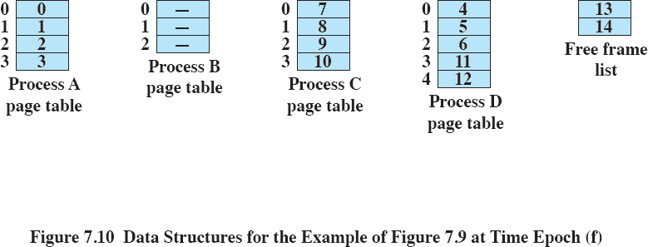
Page Table

Slide 20
Segmentation
A program can be subdivided into segments
Segments may vary in length
There is a maximum segment length
Addressing consist of two parts:
a segment number and an offset.
Segmentation is similar to dynamic partitioning.

Slide 21
Operating Systems: Internals and Design Principles, 6/E
William Stallings
Virtual Memory
Dave Bremer Otago Polytechnic, N.Z.
©2008, Prentice Hall

Slide 22
Real and Virtual Memory
:Real memory
Main memory, the actual RAM
:Virtual memory
Memory on disk
Allows for effective multiprogramming and relieves the user of tight constraints of main memory

Slide 23
Thrashing
A state in which the system spends most of its time swapping pieces rather than executing instructions.
To avoid this, the operating system tries to guess which pieces are least likely to be used in the near future.
The guess is based on recent history

Slide 24
Principle of Locality
Program and data references within a process tend to cluster.
Only a few pieces of a process will be needed over a short period of time.
Therefore it is possible to make intelligent guesses about which pieces will be needed in the future.
This suggests that virtual memory may work efficiently.

Slide 25
Support Needed for Virtual Memory
Hardware must support paging and segmentation.
Operating system must be able to manage the movement of pages and/or segments between secondary memory and main memory.

Slide 26
Paging
Each process has its own page table
Each page table entry contains the frame number of the corresponding page in main memory
Two extra bits are needed to indicate:
whether the page is in main memory or not.
Whether the contents of the page has been altered since it was last loaded.

Slide 27
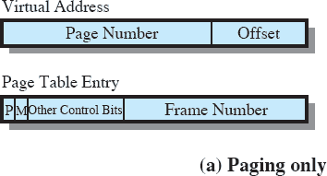
Paging Table

Slide 28
Page Tables
Page tables are also stored in virtual memory.
When a process is running, part of its page table is in main memory.

Slide 29
Translation Lookaside Buffer
Each virtual memory reference can cause two physical memory accesses
One to fetch the page table
One to fetch the data
To overcome this problem a high-speed cache is set up for page table entries
(Called a Translation Lookaside Buffer TLB)
Contains page table entries that have been most recently used

Slide 30
TLB Operation
Given a virtual address
processor examines the TLB
If page table entry is present (TLB hit)
the frame number is retrieved and the real address is formed
If page table entry is not found in the TLB (TLB miss) the page number is used to index the process page table

Slide 31
Looking into the Process Page Table
First checks if page is already in main memory.
– If not in main memory a page fault is issued
The TLB is updated to include the new page entry

Slide 32
Segmentation
Segmentation allows the programmer to view memory as consisting of multiple address spaces or segments.
May be unequal, dynamic size
Allows programs to be altered and recompiled independently
Lends itself to sharing data among processes
Lends itself to protection

Slide 33
Segment Organization
Starting address corresponding segment in main memory.
Each entry contains the length of the segment.
A bit is needed to determine if segment is already in main memory.
Another bit is needed to determine if the segment has been modified since it was loaded in main memory.

Slide 34
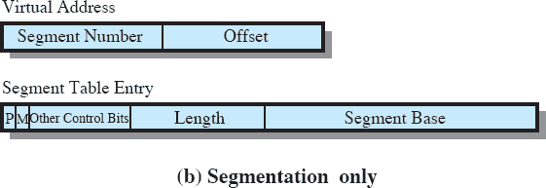
Segment Table Entries

